Slide 1
APPLIED MACHINE LEARNING FOR TEXT ANALYSIS
(24ALT3101)
Machine Learning Framework for Urban Traffic Accident Risk Prediction
Team Members:
Anjali Kasarla - 2420030170
Vinusha Muppala - 2420030212
Lasya Geethika - 2420030678
Under the Esteemed Guidance of:
Dr . KATANGURI SWANTHANA (CSE)

Slide 2
Contents
Problem Statement
Objectives
Literature Survey
Research Gap
Innovation & Creativity
Novelty
Feasibility
Project Plan
Proposed Architecture/Methodology
Datasets & Technology Stack
References

Slide 3
PROBLEM STATEMENT
Machine Learning Framework for Urban Traffic Accident Risk Prediction
Urban traffic accidents are caused by various factors such as weather, road conditions, traffic density, time, and driver-related causes. Traditional systems mainly respond after accidents occur and have limited ability to predict accident risk in advance.
The proposed system uses historical accident data and machine learning algorithms such as Logistic Regression, Decision Tree, and Random Forest to identify accident patterns and classify situations as Low, Medium, or High Risk. NLP is used to analyze accident descriptions, while SHAP/LIME explains the reasons behind predictions.
The model is evaluated using Accuracy, Precision, Recall, F1-score, ROC-AUC, and Confusion Matrix and deployed through a web dashboard to support proactive traffic safety decisions.

Slide 4
OBJECTIVES
Objectives
To develop a Machine Learning framework for predicting urban traffic accident risk.
To collect and preprocess traffic accident, weather, road, and traffic-related data.
To identify the major factors contributing to traffic accidents.
To apply machine learning algorithms such as Logistic Regression, Decision Tree, Random Forest, SVM for risk prediction.
To classify accident situations into Low, Medium, and High Risk categories.
To evaluate and compare model performance using Accuracy, Precision, Recall, F1-Score, ROC-AUC, and Confusion Matrix.
To use Explainable AI techniques such as SHAP/LIME to understand the factors influencing predictions.
To develop a web-based dashboard for accident risk prediction and visualization.
To provide an intelligent system that can support proactive traffic safety and decision-making.

Slide 5
LITERATURE SURVEY
No. | Research Paper | Model/Algorithm | Dataset Used | Pros | Cons
1 | Citywide Short-Term Crash Risk Prediction – Bao et al. (2019) | STCL-Net, CNN, LSTM, ConvLSTM | NYC crash + taxi + road + weather | Uses multiple data sources; captures spatial and temporal patterns | Tested mainly in one city; performance decreases at finer resolutions
2 | Real-Time Crash Risk Prediction using LSTM-RNN – Yuan et al. (2019) | LSTM-RNN, SMOTE, Conditional Logistic Model | Traffic detector + crash data | Good for real-time prediction; handles imbalanced crash data | Requires traffic detector infrastructure; limited explainability
3 | ML and DL Methods for Real-Time Crash Prediction – Theofilatos et al. (2019) | KNN, NB, DT, RF, SVM, NN, DL | Greece traffic + weather + crash data | Compares many ML/DL models | Dataset limited to one tollway; crash prediction remains difficult
4 | Real-Time Crash Prediction in Urban Expressway – Basso et al. (2018) | RF, SVM, Logistic Regression | Chile AVI traffic + crash data | Uses RF, SVM and LR; suitable for real-time prediction | Requires specialized AVI infrastructure; high false alarms
5 | Highway Crash Detection and Risk Estimation – Huang et al. (2020) | Deep Learning, SVM, Shallow ML | Iowa speed + volume + occupancy + crashes | Uses detailed traffic conditions for risk estimation | Requires roadside radar sensors; prediction becomes harder farther before crashes

Slide 6
No. | Research Paper | Model / Algorithm | Dataset Used | Pros | Cons
6 | Freeway Crash Risk Prediction using Probe Vehicle Data – Zhang et al. (2022) | RF, SVM, XGBoost | HERE probe-vehicle + crash data | Uses crowdsourced vehicle data; useful for real-time prediction | Probe vehicles may not represent all vehicles; limited traffic variables
7 | Motorway Segment Crash Risk Level Prediction – Nikolaou et al. (2023) | LR, DT, RF, SVM, KNN, SHAP | Greece motorway data | Risk-level prediction + SHAP explainability; compares models | Limited to one motorway; limited real-time weather/traffic information
8 | Traffic Accident Severity Prediction Based on Random Forest – Yan & Shen (2022) | RF, Bayesian Optimization, PDP | US-Accidents | Large and widely used accident dataset; strong RF classification | Predicts severity rather than future risk; limited geographical scope
9 | Enhanced MSCPO-XGBoost Accident Severity Prediction – Chen et al. (2025) | XGBoost, SVM, RF, CNN, SHAP, SMOTE | China NAIS, 2018–2023 | Combines ML + SHAP + SMOTE; handles imbalance | Relatively small dataset; China-specific; focuses mainly on severity
10 | Calibrated & Explainable Gradient Boosting – Alhawarat et al. (2026) | XGBoost, LightGBM, SHAP | US-Accidents + UK STATS19 | Large datasets + explainability + calibration; strong recent approach | Severity definition differs between datasets; transfer to new regions may be difficult

Slide 7
Real-World Applications & Existing Systems
Existing System | Description | Limitations
Google Maps | Provides navigation, traffic updates, and estimated arrival time. | Focuses on fastest route, not accident risk. Does not explain safety level.
Waze | Displays accidents and incidents reported by users. | Depends on user reports. Cannot predict future accident risk.
Road Accident Prediction Models | Predict accident occurrence using historical datasets. | Mostly rely on historical data; limited contextual information.
Accident Severity Prediction Systems | Predict how severe an accident will be. | Useful mainly after an accident has occurred.
CCTV-Based Accident Detection | Detects accidents using cameras and deep learning. | Requires expensive camera infrastructure and detects accidents after they occur.

Slide 8



RESEARCH GAP
1. Fragmented Accident Prediction Approaches
Existing studies often analyze weather, road conditions, traffic, and accident factors separately, rather than combining them into one unified prediction framework.
2. Limited Use of Textual Accident Information
Most accident prediction models primarily use structured/tabular data, with limited use of accident descriptions and other textual information for risk prediction.
3. Limited Explainability
Many machine learning models provide an accident-risk prediction but do not clearly explain which factors contributed to the prediction.
4. Lack of Integrated Risk Classification
Existing approaches often focus on accident occurrence or severity, while fewer systems provide an integrated Low, Medium, and High risk classification for proactive traffic safety.
5. Limited Real-Time Decision Support
Many models are evaluated offline and are not integrated into an accessible web-based dashboard for practical traffic-risk monitoring and decision-making.
No Unified Pipeline
re Evaluation
Persistent Human Bias
.

Slide 9
INNOVATION & CREATIVITY
INNOVATION & CREATIVITY
01 — Unified Accident Risk Framework
Combines traffic, weather, road, and accident-related factors into a single prediction system.
Provides an integrated approach to urban accident-risk assessment.
02 — NLP-Based Accident Analysis
Uses text preprocessing and feature extraction to analyze accident-related textual information.
Goes beyond simple structured-data analysis.
03 — Explainable Risk Prediction
Uses SHAP/LIME to identify the factors that influence accident-risk predictions.
Makes the ML model more transparent and understandable.
04 — Interactive Risk Dashboard
Provides Low, Medium, and High risk predictions through a web-based interface.
Supports traffic monitoring, visualization, and proactive decision-making.
Key Idea:
AI does not only predict traffic accident risk — it explains the reasons behind the prediction and supports safer traffic management.

Slide 10
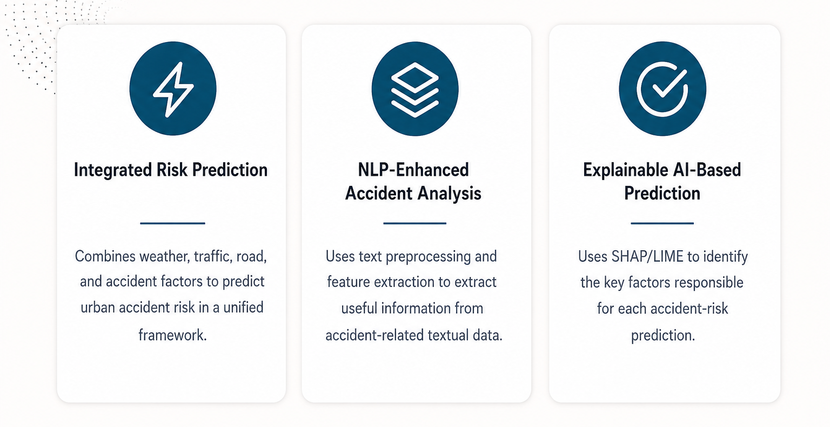
NOVALITY

Slide 11
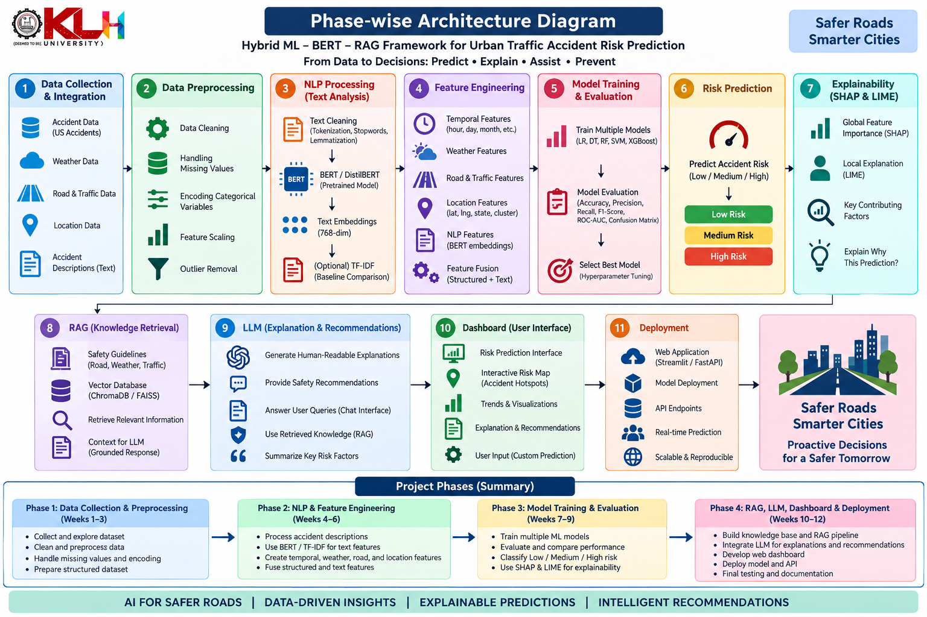
FEASIBILITY ANALYSIS

Slide 12
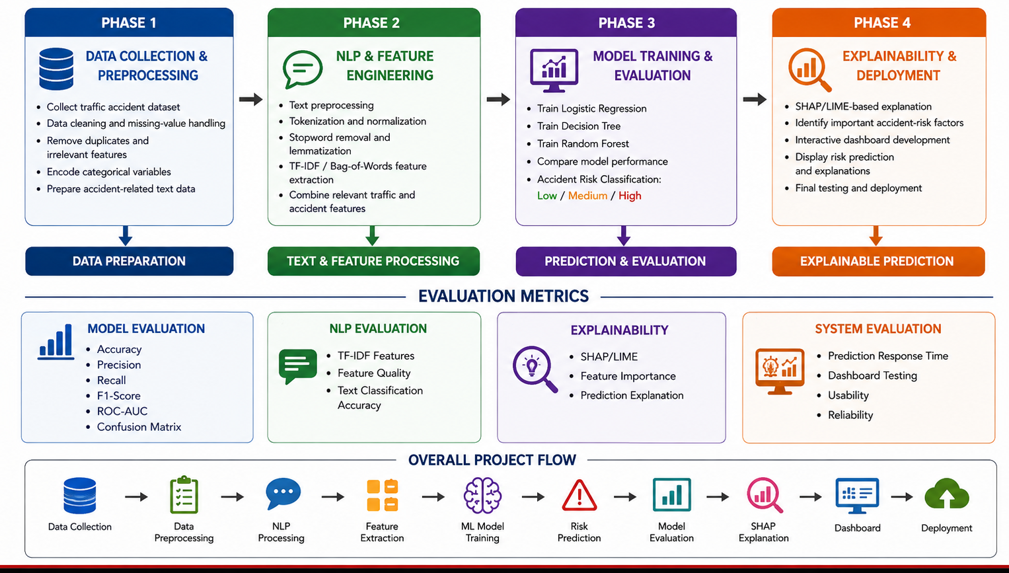
PROJECT PLAN
PROJECT PLAN
PHASE 1
PHASE 2
PHASE 3
PHASE 4
Data & Resume
Speech & Emotion
NLP & Coding
System & Testing
• Resume Parsing
• JD Processing
• Semantic Matching
• Dataset Cleaning
• Whisper Integration
• Speech → Text
• Emotion Analysis
• Audio Processing
• BERT Answer Scoring
• Semantic Matching
• Coding Assessment
• Test-Case Grading
• Dashboard Integration
• Final Report Gen.
• Full Pipeline Testing
• Deployment
MATCHING
VOICE
EVALUATION
DELIVERY
Resume Matching
Speech-to-Text
Answer Evaluation
Emotion Analysis
Similarity / Match Score
Transcription Accuracy
Semantic / Relevance Score
Classification Performance

Slide 13
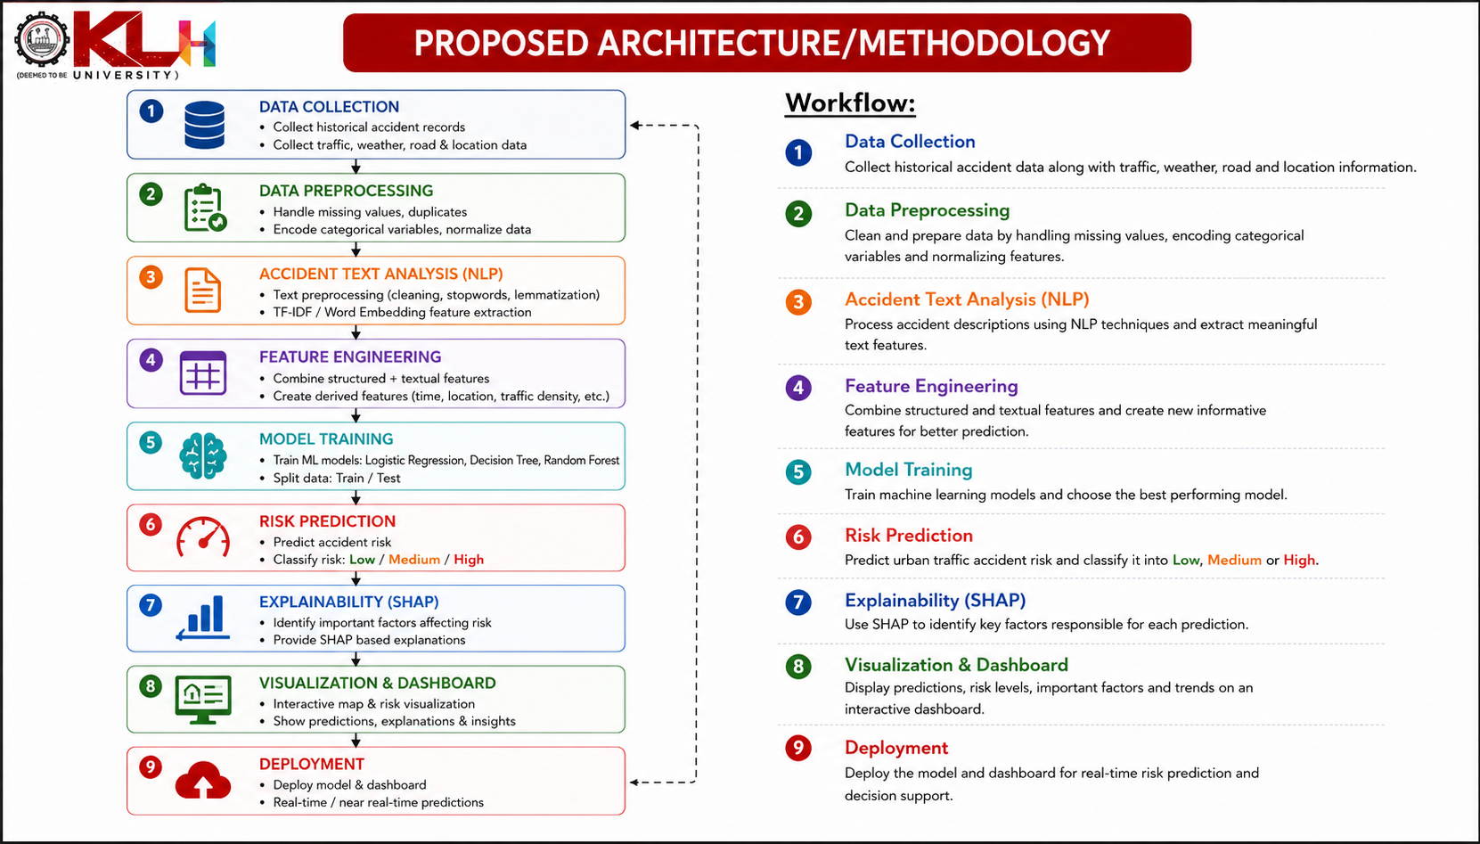
PROPOSED ARCHITECTURE/METHODOLOGY

Slide 14
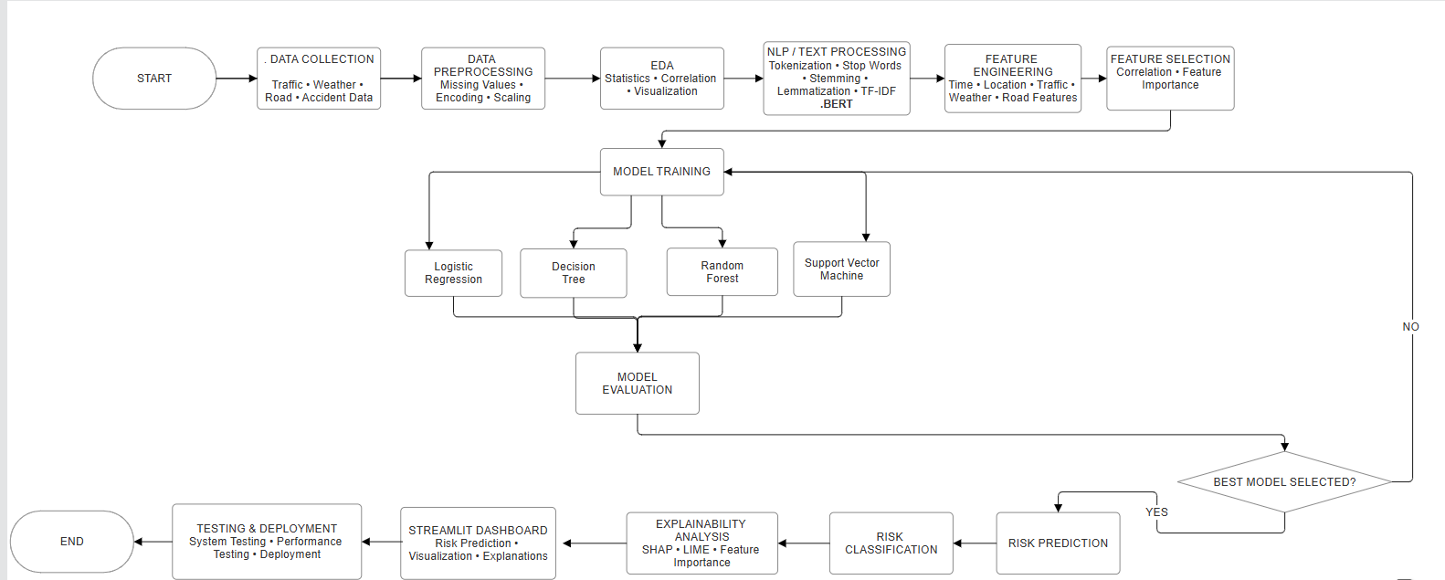
SYSTEM DESIGN

Slide 15
PERFORMANCE EVALUATION
Evaluation Metrics
Accuracy
Measures the overall percentage of correctly classified predictions.
Precision
Measures how many predicted risk cases are actually correct.
Recall
Measures how many actual cases are correctly identified.
F1-Score
Combines precision and recall into a single measure.
ROC-AUC
Measures the model's ability to distinguish between classes where applicable.
Confusion Matrix
Shows the relationship between actual and predicted risk categories.

Slide 16
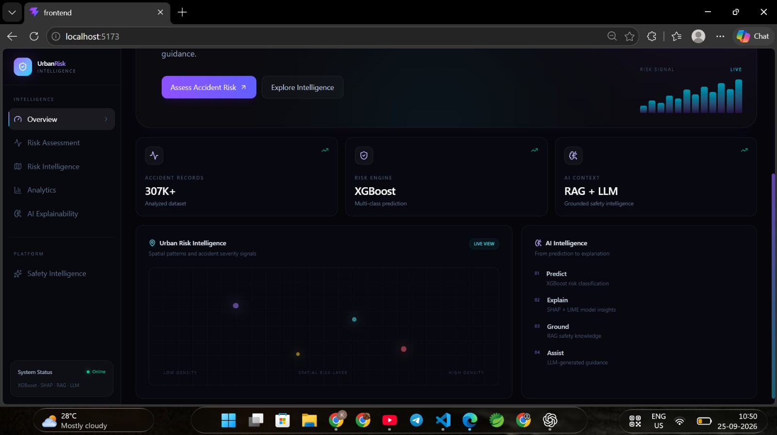
IMPLEMENTATION & RESULTS

Slide 17
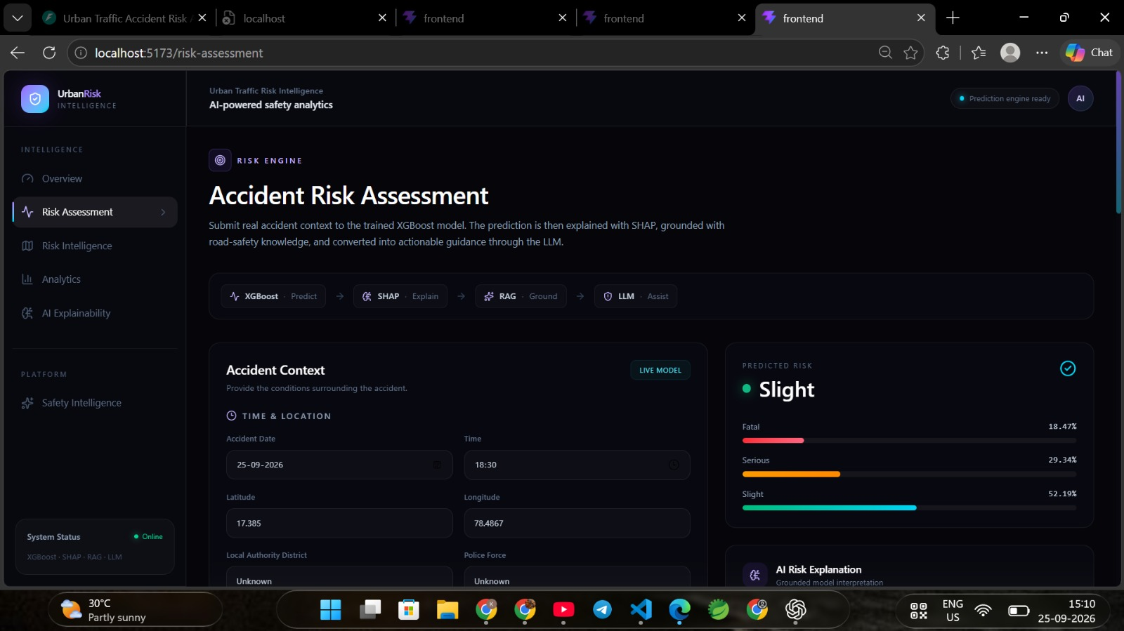

Slide 18
Thankyou

